Slide 1
Plant Disease Detection
By Aniket Malpure B190053013
Achal Tiwari B190053273
Harshvardhan Urane B190053279

Slide 2
Content
Introduction
Background
Problem Definition
Objectives
Literature Survey
Dataset
Block Diagram
Data Pre-Processing
CNN
Proposed CNN Architecture
Hyperparamters
Results
Implementaiton
Conclusion
References

Slide 3
Introduction
Plant diseases can have significant economic and environmental impacts. In terms of economics, plant diseases can lead to reduced crop yield and quality, which can cause significant losses for farmers and the agriculture industry.
In addition to the economic impact, plant diseases can also have environmental consequences. For example, some plant diseases can cause defoliation, which can lead to soil erosion and reduced soil quality.
Early detection of plant diseases is crucial for preventing their spread and minimizing their impact on crops and the environment.
By detecting plant diseases early, farmers can take appropriate measures to control the spread of the disease and prevent it from spreading to neighboring crops.

Slide 4
Background
Traditionally, plant disease detection has been performed using methods such as visual inspection, manual sampling, and laboratory analysis.
However, these traditional methods have several limitations. Visual inspection and manual sampling rely on the expertise of the observer, which can lead to low accuracy and inconsistency in disease detection.
Additionally, these methods can be time-consuming and labor-intensive, which can make them impractical for large-scale disease monitoring.
Laboratory analysis, on the other hand, can be more accurate but is often expensive and time-consuming, requiring specialized equipment and trained personnel.
As a result, there has been a growing interest in developing automated and non-invasive methods for plant disease detection, such as using computer vision and machine learning techniques like CNNs.

Slide 5
Problem Definition
To develop a model that can detect plant leaf diseases and classify them into different grades.
To implement Deep Learning and Transfer Learning approaches to field an appropriate solution to detect plant disease.

Slide 6
Objectives
To design such a system that can detect crop diseases and pests accurately.
To develop a model that can detect plant leaf diseases and classify them into different grades.
To implement various Deep Learning and Transfer Learning Algorithms for Plant Disease Detection

Slide 7
Literature Survey
Sr. No. | Paper | Author | Dataset Details | Model Architecture | Accuracy
1 | Real-time detection and identification of plant leaf diseases using convolutional neural networks on an embedded platform | Ruchi Gajjar, Nagendra Gajjar, Vaibhav Kumar Thakor, Nikhilkumar Patel, Stavan Ruperelia | Plant Village dataset – 21978 images | SSD MobileNet (Detection) + CNN (Classification) = Hybrid Model | 96.88%

Slide 8
Literature Survey
Sr. No. | Paper | Author | Dataset details | Model Architecture | Result
2 | A review of neural networks in plant disease detection using hyper spectral data | Kamlesh Golhani, Siva Balasundaram, Ganesan Vadamalai, Biswajeet Pradhan | NA | Hyper spectral imaging (Analysing a wide spectrum of light). Radial Basis Function (RBF) network with PCA (To analyse the spectra). Learning Vector Quantization (LVQ) NN to classify. | NN’s can accelerate to improve SDI (Spectral Disease Index)

Slide 9
Literature Survey
Sr. No. | Paper | Author | Dataset details | Model Architecture | Accuracy
3 | Deep learning based image processing for cotton leaf disease and pest diagnosis | Azath M., Melese Zekiowos, Abey Bruck | 2400 images collected from Wyto cotton farms | Image Digitization + Image Data Pre-processing + Feature Extraction using CNN + Dataset partitioning and model selection methodology: k-fold cross-validation + Tool selection: Keras, TensorFlow + Evaluation Technique: F1-score, precision, recall and accuracy. | 98.6%

Slide 10
Literature Survey
Sr. No. | Paper | Author | Dataset details | Model Architecture | Evaluation metrics
4 | Hybrid feature based disease detection in plant leaf using CNN, Bayesian Optimized SVM and Random Forest Classifier | Ashutosh Singh, SVN Sreenivasu, U. S. B. K. Mahalaxmi, Himanshu Sharma, Dinesh Patil, Evans Asenso | 54323 images from PlantVillage database | Data Pre-processing + Feature extraction and selection + Bayesian Optimized SVM + Random Forest Classifier | Accuracy: 96.1% Precision: 95.1%

Slide 11
Literature Survey
Sr. No. | Paper | Author | Dataset details | Model Architecture | Evaluation metrics
5 | Plant leaf disease detection using computer vision and machine learning algorithms | Sunil Harakannanavar, Jayashree Rudagi, Veena Puranmath, Ayesha Siddhiqua, R Promodhini | Village database of tomato leaves (1534 images) | Discrete Wavelet Transform (DWT) – Feature Extraction + PCA + Gray Level Coocurence matrix –Feature Selection | Accuracy: 99.09% Precision: 99.13%

Slide 12
Literature Survey
Sr. No. | Paper | Author | Dataset details | Model Architecture | Accuracy
6 | Detection of Cotton Plant Diseases using Deep Transfer learning | Vani Rajasekar, K Venu, Soumya Jena, R. Varthini, S. Ishwarya | ImageNet Database | ResNet + VGG 19 + DeepCNN | 98.0%

Slide 13
Dataset
The dataset in the project is Cotton Disease Dataset consisting of 2,297 images. The images are classified into 4 different classes:
1. Diseased Cotton Plant: It consists of 920 images available for training.
2. Diseased Cotton Leaf: It consists of 346 images available for training.
3. Fresh Cotton Plant: It consists of 513 images available for training.
4. Fresh Cotton Leaf: It consists of 518 images available for training.
The data is further split into 85% for training, 10% for validation and 5% for testing purpose to avoid overfitting of the data and calculate the accuracy of the model respectively.

Slide 14
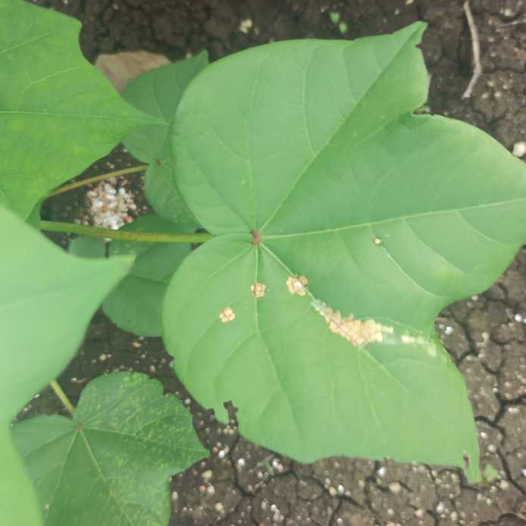
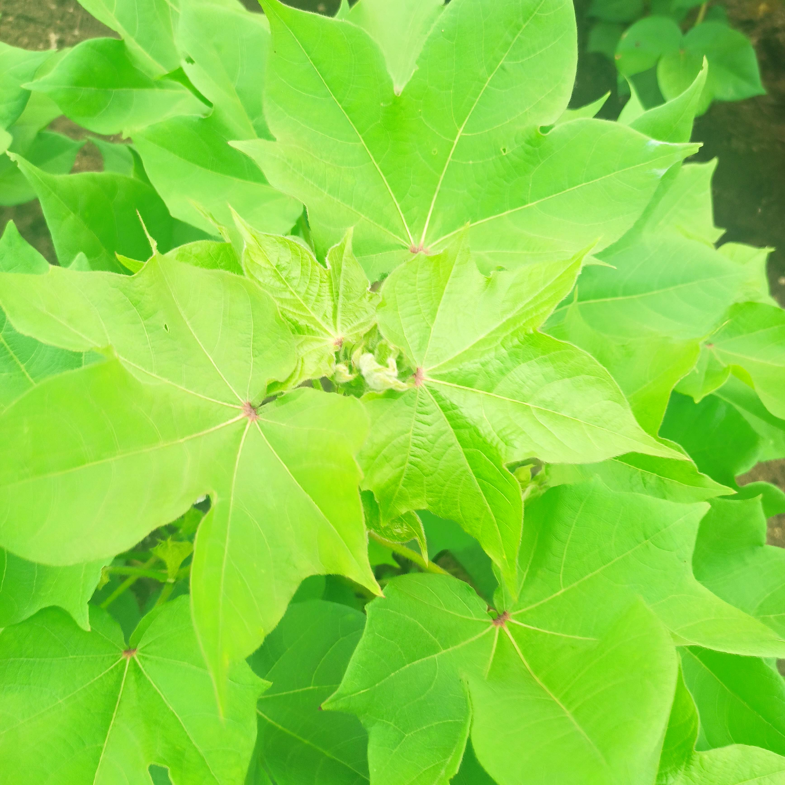
Dataset
Fig 1 Diseased Cotton Leaf Fig 2 Healthy Cotton Plant

Slide 15
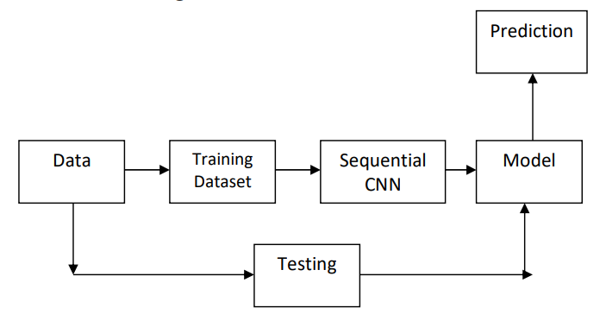
Block Diagram

Slide 16
Data Pre-Processing
Image collection: Collect the images of healthy and diseased plants from different sources and capture them in different lighting conditions, angles, and scales.
Image labeling: Manually or automatically label the images with their respective classes, such as healthy or diseased.
Data cleaning: Checking the format of every image in the and whether it is acceptable.
Data augmentation: If required, we can generate more images by applying various transformations to the existing images, such as rotation, flipping, cropping, and scaling. This can help to increase the size of the dataset and make the model more robust to variations in real-world scenarios.

Slide 17
Data Pre-Processing
Data normalization: Normalize the pixel values of the images to a common scale, such as [0, 1], to ensure that the model can learn the patterns in the images effectively.
Data splitting: Split the dataset into training, validation, and testing sets. The training set is used to train the model, the validation set is used to tune the hyperparameters of the model, and the testing set is used to evaluate the performance of the model.
Data loading: Load the images and their corresponding labels into memory using data loaders, which can efficiently handle large datasets and enable batch processing.
By performing these preprocessing steps, we can prepare the dataset for training the CNN model for plant disease detection. These steps are important to ensure that the model can learn the patterns in the images effectively and generalize well to new, unseen images.

Slide 18
CNN
A Convolutional Neural Network (CNN) is a type of neural network commonly used in image classification and recognition tasks. CNNs are designed to automatically learn and extract meaningful features from raw image data by using convolutional layers.
The basic building blocks of a CNN are convolutional layers, pooling layers, and fully connected layers.
The convolutional layers consist of a set of filters that are convolved with the input image to extract features. Each filter slides over the input image and performs element-wise multiplication and addition of the filter weights with the pixel values in the input image. The result of this operation is a feature map that represents a specific feature or pattern in the image.

Slide 19
CNN
The pooling layers are used to reduce the spatial size of the feature maps and to make the model more computationally efficient. The most common type of pooling operation is max-pooling, which extracts the maximum value from a local region of the feature map.
The fully connected layers are used to classify the image based on the extracted features. These layers are similar to those in a traditional neural network and are used to learn the mapping between the extracted features and the output class labels.

Slide 20
CNN Architectures
AlexNet: It consists of 5 convolutional layers, 3 max-pooling layers, and 2 fully connected layers.
VGGNet: It consists of up to 19 layers, with 16 convolutional layers, 5 max-pooling layers, and 3 fully connected layers.
InceptionNet: InceptionNet, also known as GoogLeNet. It consists of multiple parallel convolutional layers with different filter sizes, followed by pooling layers and a global average pooling layer.
ResNet: It consists of residual blocks that allow for deeper networks without suffering from vanishing gradients.
DenseNet: It consists of dense blocks that allow for better feature reuse and a reduction in the number of parameters.

Slide 21
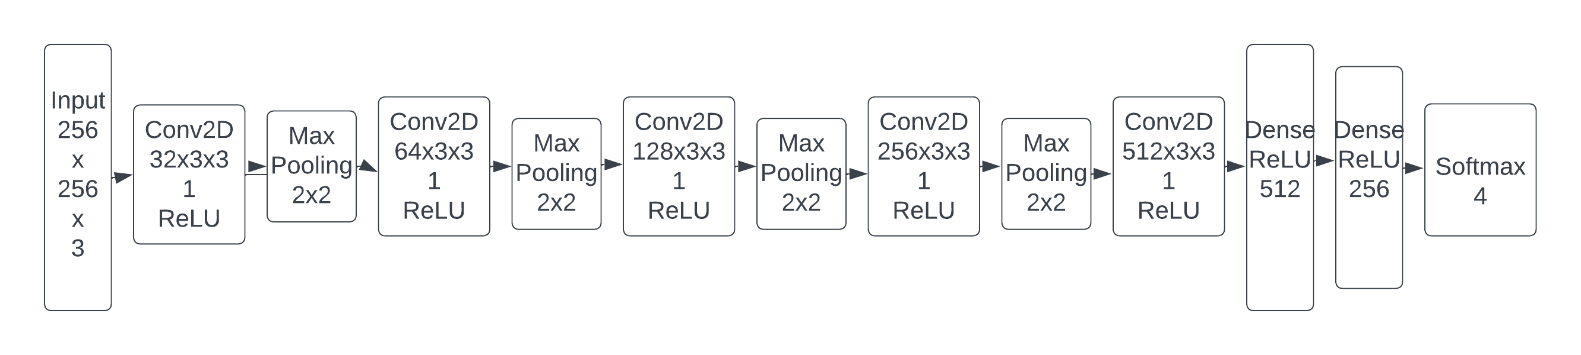
Proposed CNN Architecture

Slide 22
Proposed CNN Architecture
It consists of 5 Convolutional layers, 4 Max Pooling layers, 2 Dense layers and a Softmax classifier layer consisting of 4 classes.
The input size of the image to the propose model is 256 x 256 x 3.
The number of filters in the convolutional layer 1 to 5 are 32, 64, 128, 256 and 512 respectively.

Slide 23
Proposed CNN Architecture
Let's briefly explain the components of the CNN model:
1.Input Image: The initial input to the CNN is an image. Each pixel in the image represents a feature, such as color intensity.
2.Convolutional Layer: The convolutional layers perform feature extraction by applying convolutional filters to the input image. Each filter captures specific patterns and features within the image.
3.Activation: The activation function introduces non-linearity to the model, allowing it to learn complex relationships between features. Common activation functions include ReLU (Rectified Linear Unit), sigmoid, and tanh.
4.Max Pooling: Max pooling reduces the spatial dimensions of the feature maps, decreasing the model's sensitivity to small spatial variations while retaining the most relevant information. It helps with translation invariance and reduces computational complexity.

Slide 24
Proposed CNN Architecture
5.Flatten: The flatten layer converts the multi-dimensional feature maps into a one dimensional vector, which serves as input for the fully connected layers.
6.Fully Connected Layer: Fully connected layers are traditional neural network layers, where each neuron is connected to every neuron in the previous and subsequent layers. These layers learn high-level representations based on the extracted features.
7.Output: The final layer provides the output of the model, which could be a class prediction in classification tasks or continuous values in regression tasks. The activation function used in the output layer depends on the specific task requirements (e.g., softmax for multi-class classification).

Slide 25
Hyperparameters
Some common hyperparameters used in the training process of a CNN include:
Learning rate:
This is the rate at which the weights and biases of the CNN are updated during training.
A higher learning rate can lead to faster convergence, but it may also cause the model to overshoot the minimum of the loss function and fail to converge.
The proposed system has learning rate equal to 0.0001.
Batch size:
This is the number of images that are processed in a single iteration during training.
A larger batch size can lead to faster convergence, but it also requires more memory and computational resources.
The proposed system has batch size as 32.

Slide 26
Hyperparameters
Number of epochs:
This is the number of times the training set is passed through the CNN during training.
Training for too few epochs may result in underfitting, while training for too many epochs may result in overfitting.
The proposed model is trained on 100 epochs with a patience of 3.
Dropout rate:
This is a regularization technique that randomly drops out a fraction of the neurons in the network during training.
Dropout can help prevent overfitting and improve generalization performance.

Slide 27
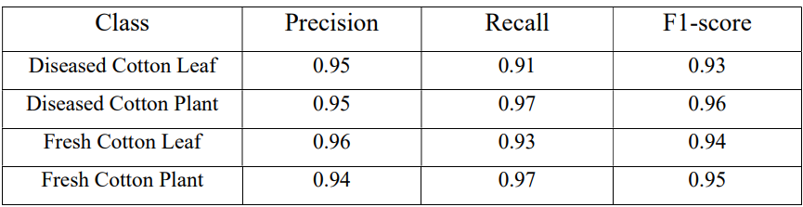
Results
The proposed model produced 99.23% accuracy with 98.66% validation accuracy.

Slide 28
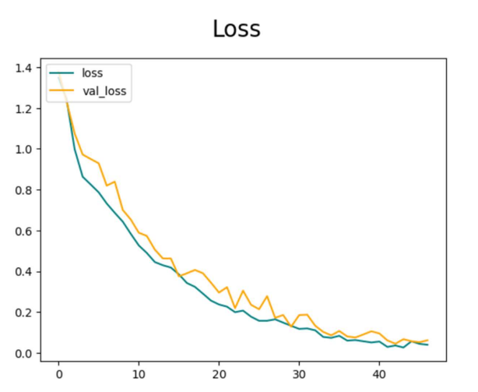
Results
Loss Plot

Slide 29
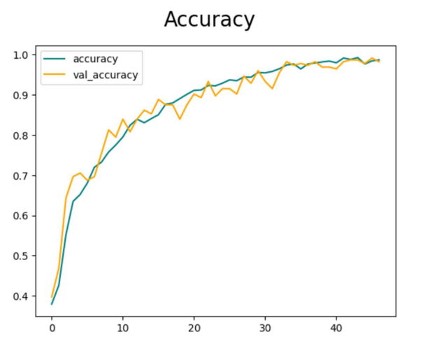
Results
Accuracy Plot

Slide 30

Implementation
Input Image to the classifier Output of the classifier

Slide 31
Conclusion
In conclusion, the use of CNNs for plant disease detection has shown promising results in recent years. By leveraging the power of deep learning, CNNs can automatically learn complex features from plant images and accurately classify them into different disease categories.
Convolutional Neural Network architecture is used to build the deep learning model, which has an accuracy of 98.66%. The transfer learning model is implemented using ResNet152V2 and InceptionV3. With 20 epochs taken into account, the accuracy obtained using InceptionV3 is 92.00% and the validation loss is 0.3659. While taking 20 epochs into account, ResNet152V2 has a validation loss of 0.6964 and obtained an accuracy of 94.00%.

Slide 32
References
Gajjar, R., Gajjar, N., Thakor, V. J., Patel, N. P., & Ruparelia, S. (2021). Real-time detection and identification of plant leaf diseases using convolutional neural networks on an embedded platform. The Visual Computer, 1-16.
Golhani, K., Balasundram, S. K., Vadamalai, G., & Pradhan, B. (2018). A review of neural networks in plant disease detection using hyperspectral data. Information Processing in Agriculture, 5(3), 354-371.
Zekiwos, M., & Bruck, A. (2021). Deep learning-based image processing for cotton leaf disease and pest diagnosis. Journal of Electrical and Computer Engineering, 2021, 1- 10.
Singh, A. K., Sreenivasu, S. V. N., Mahalaxmi, U. S. B. K., Sharma, H., Patil, D. D., & Asenso, E. (2022). Hybrid feature-based disease detection in plant leaf using convolutional neural network, bayesian optimized SVM, and random forest classifier. Journal of Food Quality, 2022, 1-16.

Slide 33
References
Harakannanavar, S. S., Rudagi, J. M., Puranikmath, V. I., Siddiqua, A., & Pramodhini, R. (2022). Plant leaf disease detection using computer vision and machine learning algorithms. Global Transitions Proceedings, 3(1), 305-310.
Rajasekar, V., Venu, K., Jena, S. R., Varthini, R. J., & Ishwarya, S. (2021). Detection of cotton plant diseases using deep transfer learning. Journal of Mobile Multimedia, 18(2), 307-324.

